Slide 1
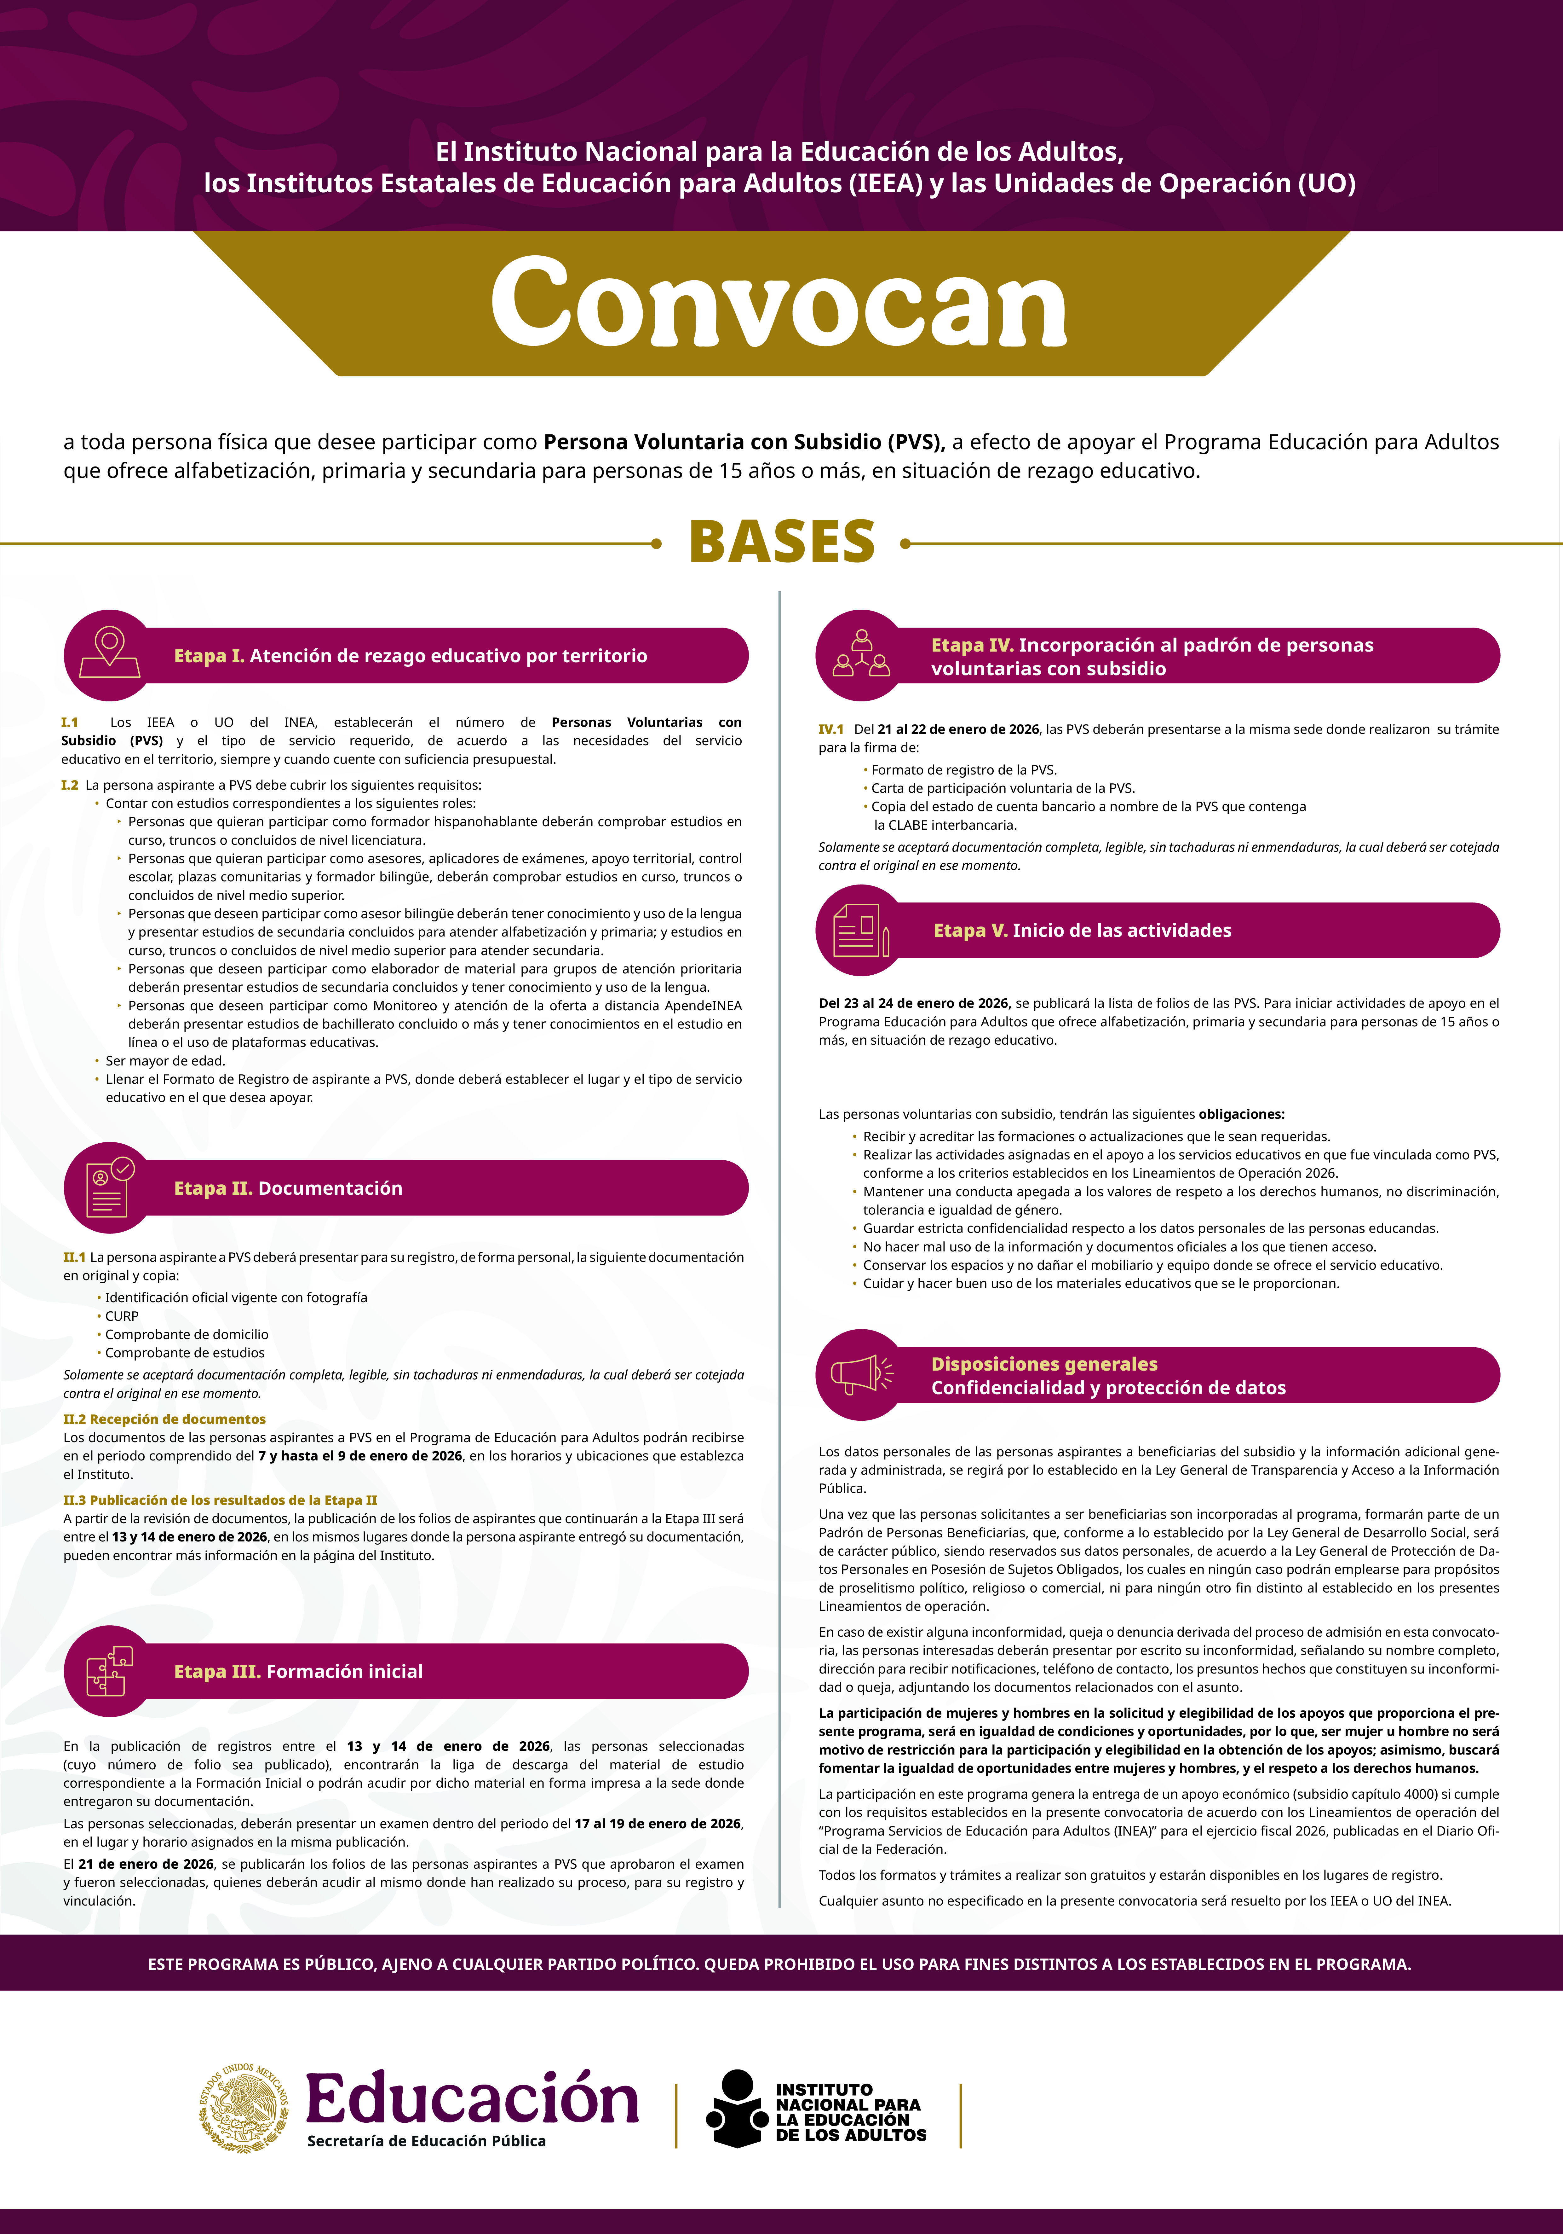

https://www.iseja.gob.mx/
https://www.iseja.gob.mx/

